Slide 1
ECE 3003 - MICRO CONTROLLER AND ITS APPLICATIONS REVIEW 2 PASSWORD BASED DOOR LOCK SYSTEM
TEAM MEMBER - FACULTY –
ARPIT PATAWAT 19BEC0358 PROF. KARTHIKEYAN A
SARANSH 19BEC0347
SUJAL MEHTA 19BEC0091
RAJENDRAN HARIPRASAD 19BEC0395
VETRI T SELVAM 19BEC0343

Slide 2
INTRODUCTION
Our project is a digital password-based door lock. The lock works by verifying the input password with the predefined passcode. This door lock is operated with the help of 8051 microcontroller.
In this project, we have designed the digital door lock using an 8051 microcontroller, a keypad, LCD , Stepper motor , motor driver and buzzer.
The system collects 5 digit user input, compares the user input with the preset password inside the program, and if the user input and stored password matches, access will be granted by rotating stepper motor 90 degree and then closing it after some time
If the user enters wrong password then door will remain lock and status will be displayed on the screen. If he gives wrong password continuously then our buzzer will start alarming

Slide 3
BLOCK DIAGRAM
User inputs password via KEYPAD
Check the password with the actual password
Correct
Incorrect
display access granted it on LCD
Display access denied on LCD
Open gate for some time then close it
Decrement number of attempts
Return to Initial State

Slide 4
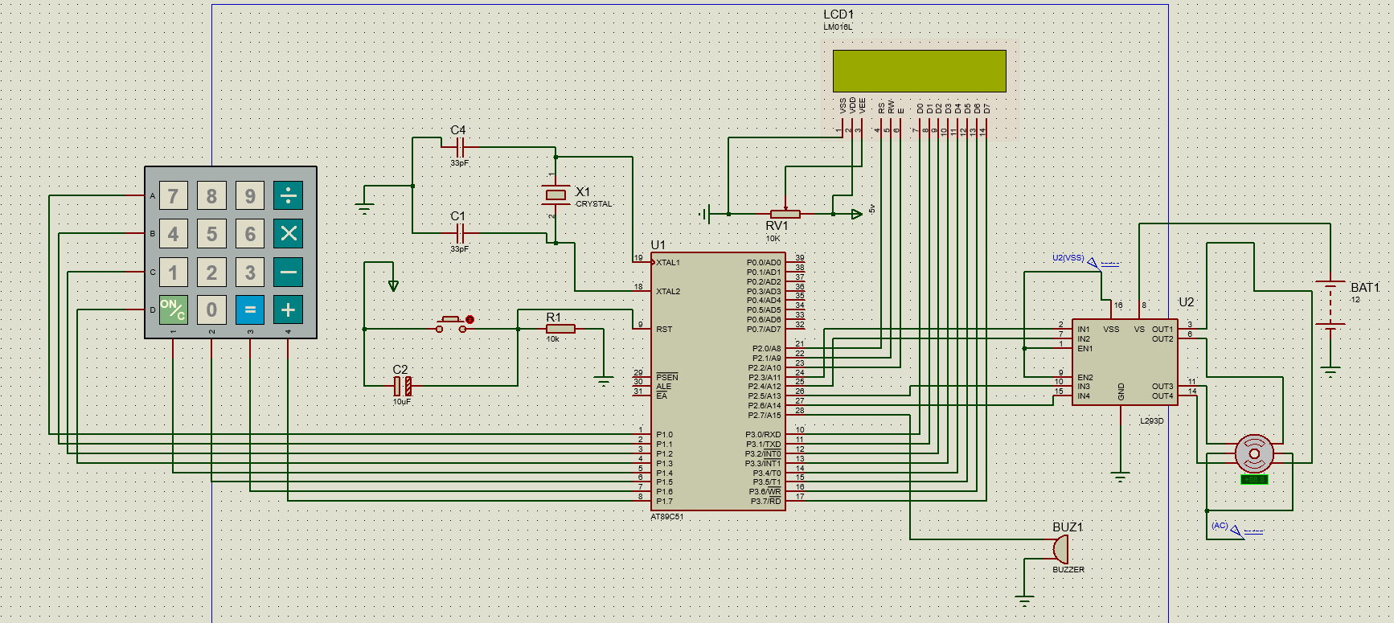
CIRCUIT DIAGRAM

Slide 5
COMPONENTS USED
AT89C51- our 8051 micro controller
4 X 4 Keypad – we will use this to take input password
LCD – to display status, number of attempts left
L293D motor driver – to controller Stepper motor
Stepper motor – to open and close gate by rotating 90 degrees]
Buzzer – used as an alarm when user types wrong password for 3 time

Slide 6
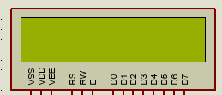
LCD INTERFACING
PIN layout -
VCC – Ground, VDD – 5V , VEE to variable register of 10K ohm
Register Selector – P2.0, Read/Write – P2.1, Enable- P2.2
D0 – D7 - Port 3
Algorithm to send command-
Copy the command value to port 3
Make register select = 0
Select write mode by making R/W = 0
Give a high to low Pulse to enable (port value high , delay then low)
Algorithm to send/display data
Copy the ASCII value of data to port 3
Make register select = 1
Select write mode by making R/W = 0
Give a high to low Pulse to enable (port value high , delay then low)

Slide 7
LCD INTERFACING
LCD commands used to initialize – ASCII value -
38 – 2 lines and 5X7 Matrix LCD
0E – Display on cursor Blinking
01 – Clear display screen
06 – Increment cursor to right
80 – Force cursor to the beginning to first line
C0 – Force cursor to the beginning to our
Second line
Decimal value | ASCII VALUE
00 | 48
01 | 49
02 | 50
03 | 51
04 | 52
05 | 53
06 | 54
07 | 55
08 | 56
09 | 57

Slide 8
LCD INTERFACING
Algorithm to display string text –
Define string using DB command at some address
Add 0 at the end
Move data pointer to that address
Take first byte of String and move to accumulator A
Display this data of A to LCD
Increment DPTR up to we get 0

Slide 9
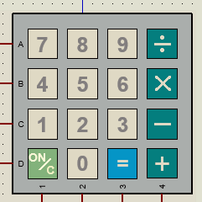
KEYPAD INTERFACING
PIN layout -
ABCD (Rows) – Port 1.0 – Port 1.3
1234 (Columns) – Port 1.4 – Port 1.7
Algorithm to Read key press-
make all the rows and columns high (1)
make the starting row = ground/low (0)
If the user will press any key from starting row, then that column will become 0 indicates that key is pressed
Check for all the columns if it is low then load the ASCII value of the key to accumulator and stop the process
If none of the column is low, then make this row 1 and repeat the same process for the other rows.
For 5 input we have to check continuously until we get 5 input

Slide 10
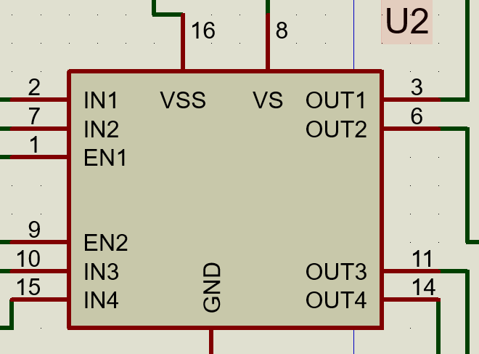
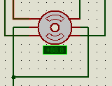
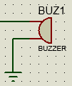
MOTOR DRIVER, STEPPER MOTOR and buzzer INTERFACING
PIN layout -
IN1– Port 2.3 IN2 –Port 2.4
IN3 –Port 2.5 IN4 – Port 2.6
EN1, EN2 and VSS– 5V
VS – 12 volt battery
OUT 1,2,3,4 – 4 ports of Stepper motor
Algorithm to Read key press-
Send high signal to port 2.5 and 2.6 to rotate 90 degrees clockwise
Send high signal to port 2.3 and low to port 2.5 to rotate 90 degrees anti clock wise
Algorithm for buzzer –
Set both port low
Whenever we want buzzer to make sound, send high input to 1 of the ports

Slide 11
ALGORITHM USED IN OUR PROGRAM
Ser number of attempts (R5) = 3
Initialize LCD
Display “ENTER 5 DIG. CODE” and Move to next line of LCD
Take 5 key inputs from user and store it at the memory location 160-164 and display them in LCD as well
Display “CHECKING CODE…” message and check with the actual password
ALGORTIHM for checking password -
DPTR will point to actual password label whilst R1 will point to location 160
First load first byte of actual password from DPTR to A and XOR with the first byte of R1. If both number happens to be same then XOR will make Accumulator = 0
If A = 0 then repeat the same process for 4 times more for the next data then move to SUCCESS label
If A != 0 then move to FAIL label

Slide 12
ALGORITHM USED IN OUR PROGRAM
SUCCESS
Display “ACCESS GRANTED” then move to next line and display “OPENING DOOR” message to LCD
Rotate the stepper motor by 90 degrees and wait for some time then display “CLOSING DOOR” message and rotate motor anti clockwise to its initial position
Set number of attempts = 3
FAIL
Display “WRONG CODE” then move to next line and display ”ACCESS DENIED” message to LCD
Decrement number of attempts and go to starting of function and if it is zero (attempts value) then display “INDTRUDER ALERT !” and start the buzzer to make sound for 10 times then set attempt value = 3 and move at the starting of function

